Slide 1
INF10025
Data Management and Analytics
Week 5 – Part 3
Entity Relationship Modelling and Diagrams
SQL

Slide 2
SQL: Why learn SQL?
Why learn SQL DML? Why not just use a GUI interface just like Access?
Programmers write SQL statements in their code
  A C# or VB or PHP applications request data from a database for student data.
  Programmer embeds SQL statement in code
  "SELECT Id, Name FROM Student where Id = 1234" (or where id = [stuid_textbox] )
GUI software actually generates SQL statements
  The user usually doesn't see the SQL statement
  Experts sometimes need to modify / tweak the SQL
Database Administrators / Programmers use DML
Business Intelligence workers who know a bit of SQL
  Don't have to wait for database experts to write simple code
  3 days wait for SELECT * FROM STUDENT to be coded.
Some power end users use SQL statements when existing systems / reports are lacking
Used in INF20010 Database Systems (2nd database unit)
DML = data manipulation language

Slide 3
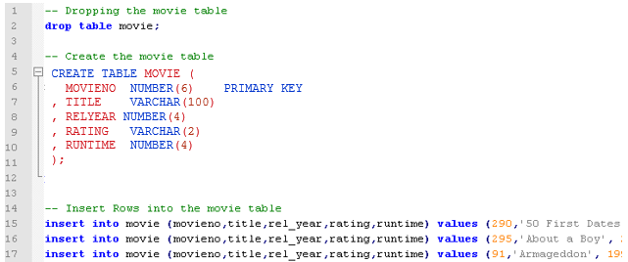
Saving your work & Notepad++
SQL statements typed into ISQL JR are not saved
Solution. Copy and Paste the SQL statements into a text file.
  Save the file on USB or Network drive
Notepad++ is far more powerful than Microsoft's Notepad.EXE
  Notepad++ is free
    Download Notepad++ to your USB / network drive
    It can automagically highlights / colours SQL features
      From the menu choose Language / S / SQL. It will highlight:
          Keywords
          Comments
          Numbers
          Strings
          Functions
      Other editors:
      Sublime
      Brackets
      many more

Slide 4
SQL: DDL & DML
Structured Query Language (SQL) is the language used by all RDBMSs
SQL statements can generally be placed in one of two groups:
  DDL - Data Definition Language – maintains the database structures / objects
      CREATE TABLE
      ALTER TABLE
      DROP TABLE…
  DML - Data Manipulation Language – works with data within the database
      Inserting Data
      Querying Data (SELECT)
      Updating Data
      Deleting Data…

Slide 5
SQL DDL: CREATE TABLE
Syntax:
  CREATE TABLE <table-name> (
  <Column-name1> <data-type> [<max length>] ,
  [ , <Column-name2> <data-type> [<max length>] ]…
  [ , PRIMARY KEY (<column-name>) ]
  [ , FOREIGN KEY (<column-name>) REFERENCES (<table-name>) ] ) ;
Words in uppercase green are Oracle Keywords
Words within < > symbols are user defined. You supply the words
Words within [ ] symbols are optional.

Slide 6
SQL DDL: CREATE TABLE
  CREATE TABLE Lecturer (
    LecId number
    , LecName varchar (50)
    , Age number
    , PRIMARY KEY (LecId)
    ) ;
  CREATE TABLE Subject (
    SubjectCode varchar (10)
    , Title varchar (100)
    , CreditPoints number
    , LecId number
    , PRIMARY KEY (SubjectCode)
    , FOREIGN KEY (LecId) REFERENCES Lecturer
    ) ;
Commas and brackets are important.
Errors if not used correctly.
Short Text is replaced by varchar()
varchar requires a maximum length value

Slide 7
SQL DML: INSERT STATEMENT
Adding data to a table is done via Insert statements
You must specify the table name, column names, the values to be inserted
Syntax:
  INSERT INTO <table-name> (<column-name1> , <column-name2> , …)
  VALUES ( <value1> , <value2> , … ) ;
  Text data must be surrounded by single quotes (not double quotes in Oracle)
  Numeric data does not have quotes.
    No punctuation is used (no commas, dollar signs…)
E.g. INSERT INTO Lecturer ( LecId, LecName, Age )
VALUES (207, 'John Smith', 37) ;

Slide 8

BEWARE of Smart Quotes
Microsoft's Notepad or Don Ho's Notepad++ are typically used as
SQL text editors (there are many others).
Beware of Word Processors such as MS Word.
Really beware of the Smart Quote feature.
Smart quotes are fancy looking quote symbols
…VALUES (207, 'John Smith', 37) ; using notepad
…VALUES (207, ‘John Smith’, 37) ; using MS Word
The problem is that RDBMS software such as Oracle does not recognize smart quotes.
So Oracle does not view ‘John Smith’ as a text value.
Error at line 1:
ORA-00911: invalid character

Slide 9
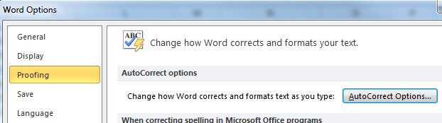
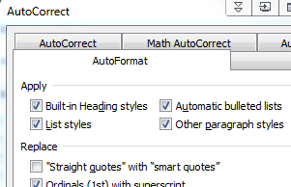
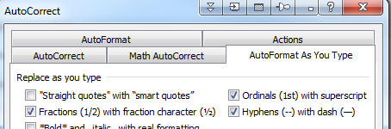
BEWARE of Smart Quotes
Solutions:
1. Don’t use MS Word (or Powerpoint or Onenote…)
2. If you a forced to, then disable the appropriate Auto Correct options within MS Word

Slide 10
SQL DML: INSERT STATEMENT
Code required to add 4 rows to the existing tables:
  INSERT INTO Lecturer ( LecId, LecName, Age )
  VALUES (207, 'John Smith', 37) ;
  INSERT INTO Lecturer ( LecId, LecName, Age )
  VALUES (345, 'Carol Kent', 34) ;
  INSERT INTO Subject ( SubjectCode, Title , CreditPoints, LecId )
    VALUES ('HIT1405', 'Intro to Web', 12.5, 207) ;
  INSERT INTO Subject ( SubjectCode, Title , CreditPoints, LecId )
    VALUES ('HIT1407', 'EBIS', 12.5, 345) ;

Slide 11
SQL DML: INSERT STATEMENT
Nulls
If a value is unknown, then use the Null keyword
INSERT INTO Lecturer ( LecId, LecName, Age )
  VALUES (974, ‘Robert Tipping', Null) ;

Slide 12
SQL DML: SELECT STATEMENT
The remainder of this lecture examines the SELECT clause
The Select clause is how users extract / display data stored in database tables
Syntax:
  SELECT <item>
  FROM <table name>
  …
Example:
  SELECT LecId, LecName, Age
  FROM Lecturer ;
Output / Result Set:
Each column name in the SELECT clause,
causes a column to be included in the result set.
The sequence of column names in the select clause matches the sequence of columns in the result set
LecId | LecName | Age
207 | John Smith | 37
345 | Carol Kent | 34

Slide 13
SQL: SELECT columns
Only columns specified in the Select Clause are returned
Sequence of columns is based on the sequence of column names
The * symbol can be used to indicate all columns are required
SELECT lecid, lecname
FROM lecturer;
Age | LecName
37 | John Smith
26 | Jane Pitt
34 | Carol Kent
LecID | LecName
207 | John Smith
119 | Jane Pitt
345 | Carol Kent
SELECT age, lecname
FROM lecturer;
LecID | LecName | Age
207 | John Smith | 37
119 | Jane Pitt | 26
345 | Carol Kent | 34
SELECT *
FROM lecturer;

Slide 14
SQL:DELETE command
When deleting rows in a table, it is a good idea to create a Select statement first.
Suppose you want to delete all movies that have a run_time < = 100
Select the rows first SELECT *
FROM Movie
WHERE Run_time < =100 ;
Check the result set. Are these the rows you want to delete?
Once satisfied, simply change the first few words of the statement:
Change from SELECT * FROM Movie to
        DELETE
        From Movie
WHERE Run_time <= 100 ;

Slide 15
SQL:Update command
Updates one or more rows in a single table.
UPDATE <table-name>
SET <column-name> = <value> [ , … ]
WHERE <condition>
          UPDATE student
          SET Fees_Paid = 'Y'
          WHERE StuID = 1122334
          Warning. If you do not include the where clause, ALL rows from the table
          will be updated!
          ▪ Many DBMSs do not have an Undo or Oops feature.
          ▪ Suggestion: Before updating, write a Select statement. Check the rows selected.
          Then convert the Select statement to an Update statement

Slide 16
SQL:Update command
This example updates multiple columns in the same statement.
UPDATE <table-name>
SET <column-name> = <value> [ , … ]
WHERE <condition>
UPDATE employee
SET salary = salary + 5000,
WHERE UPPER(branch) = 'HAWTHORN'
OR years_of_service >= 10;

Slide 17
SQL: Order By– sequence of result set rows
The Order By clause specifies the sequence of rows in the result-set.
    Use the column name or column number
    Multiple columns can be specified.
    Each column may be ordered in ASCending or DESCending sequence. Ascending is the default
LecName | Age
Carol Kent | 34
Jane Pitt | 26
John Smith | 37
SELECT LecName, Age
FROM lecturer
ORDER BY LecName;
LecName | Age
John Smith | 37
Jane Pitt | 26
Carol Kent | 34
SELECT LecName, Age
FROM lecturer
ORDER BY LecName DESC;
LecName | Age
Jane Pitt | 26
Carol Kent | 34
John Smith | 37
SELECT LecName, Age
FROM lecturer
ORDER BY Age ASC;

Slide 18
SQL: Order By – column number
A column number in the Order By clause
  refers to one of the columns in the select clause.
  This can be useful in more complex queries
  This example sequences the result set by the 3rd column listed in the select clause
So 3 means "Sort the displayed rows by the 3rd column of the result set"
①
②
③
LecID | LecName | Age
207 | John Smith | 37
345 | Carol Kent | 34
119 | Jane Pitt | 26
SELECT LecId, LecName, Age
FROM lecturer
ORDER BY 3 DESC;

Slide 19
SQL: Order By– multi column
Multiple columns can be used the Order By clause
Rows in the result set are in ascending age sequence
Then within each age group, the rows are in ascending name sequence
SELECT LecName, Age FROM Lecturer ORDER BY Age, LecName
①
②
Original
Table
LecID | LecName | Age
207 | John Smith | 37
345 | Carol Kent | 34
119 | Jane Pitt | 26
231 | Jim Brady | 26
118 | Sanjay Parekh | 34
521 | Lisa Simmons | 21
404 | Bruce Lee | 34
103 | Aaron Peters | 26
Result
Set
LecName | Age
Lisa Simmons | 21
Aaron Peters | 26
Jane Pitt | 26
Jim Brady | 26
Bruce Lee | 34
Carol Kent | 34
Sanjay Parekh | 34
John Smith | 37

Slide 20
SQL: Coding Rules & Debugging
Your SQL statements will often cause errors. Most errors are caused by
    misspelling column names
    misspelling table names
    misspelling keywords
    excluding commas
Each of these statements will cause an Oracle Error
    SELECT LecId LecName Age FROM LECTURER ;
SELCT LecId, LecName, Age FROM LECTURER ;
SELECT LecId, LecName, Age FORM LECTURER ;
SELCT LecId, LecName, Age FROM LECTURE ;
SELCT LecId, LectName, Age FROM LECTURER ;
LecId | LecName | Age
207 | John Smith | 37
345 | Carol Kent | 34

Slide 21
SQL: Coding Rules & Debugging
Errors are not typically caused by Text Case, Spaces, Multiple Lines and Semicolons
  The Case of SQL keywords is not important.
    SELECT LecId, LecName, Age FROM Lecturer ;
    select lecid, lecname, age from lecturer ;
  Number of spaces between key words and commas is not important
    SELECT LecId,LecName,Age FROM Lecturer ;
    SELECT LecId , LecName , Age FROM LECTURER ;
  An SQL statement may be split over any number of lines
  SELECT LecId, LecName, Age FROM Lecturer ;
  SELECT LecId, LecName, Age
  FROM Lecturer ;
  Semi-colon to terminate each statement is optional.
    SELECT LecId, LecName, Age FROM Lecturer ;
SELECT LecId, LecName, Age FROM Lecturer
Though Semi-Colons are essential when combining multiple statements in a script
is same as
is same as
is same as
is same as

Slide 22
SQL: DML – SELECT statement clauses
  A SELECT statement may have additional clauses
      Clauses must be in the correct sequence
      Most clauses are optional
      Each clause begins with a KEYWORD
      For easy reading the KEYWORD is written in UPPER CASE
  SELECT empno, branch, salary
  FROM employee
  WHERE branch = 'KEW'
  ORDER BY branch, empno;
    This statement has 4 clauses
      The SELECT clause
      The FROM clause
      The WHERE clause
      The ORDER BY clause
Keywords

Slide 23
SQL: WHERE clause – restricting rows
Syntax: SELECT …
FROM …
[WHERE <search-condition> ]
[ORDER BY …]
The WHERE clause specifies a condition(s) that each row must satisfy to be included in the result set.
SELECT *
FROM Lecturer
WHERE Age < 35
Each row in the table is evaluated against the condition
  If the condition is true (i.e. the age is < 35) then the row is included in the result set.
The WHERE clause is often referred to as a Restriction
  The clause reduces the number of rows in the result set.

Slide 24
SQL: WHERE clause – comparison operators
SQL has many operators that compare two values
  = Equal to
  <> Not equal to (can use != in most DBMSs)
  < Less than
  <= Less than or Equal to (two keystrokes < and = in that order)
  > Greater than
  >= Greater than or Equal to
SELECT * FROM lecturer
WHERE Age = 34; - - - - 2 rows selected
…WHERE Age < 34; - - - - 4 rows selected
…WHERE Age <> 21; - - - - 6 rows selected
…WHERE Age >= 34; - - - - 3 rows selected
…WHERE Age > 34; - - - - 1 rows selected
…WHERE Age <= 50; - - - - 7 rows selected
…WHERE Age < 20; - - - - 0 rows selected
LecID | LecName | Age
521 | Lisa Simmons | 21
103 | Aaron Peters | 26
119 | Jane Pitt | 26
231 | Jim Brady | 26
404 | Bruce Lee | 34
118 | Sanjay Parekh | 34
207 | John Smith | 37

Slide 25
SQL: Numeric literal values
When specifying numeric literals
  Do not use quotes
  Do not include formatting
  You may use decimal points and leading negative signs
    … WHERE annual_budget < 50000 OK
    … WHERE annual_budget < 50,000 X
    … WHERE annual_budget < '50000' X
    … WHERE annual_budget > 9.99 OK
    … WHERE annual_budget > -100000 OK

Slide 26
SQL: String literal values
When specifying string / text / character literals
  You must use quotes
    Oracle, SqlServer, MySQL use single quotes
    MSAccess uses double quotes
    … WHERE Gender = 'M' OK
    … WHERE Gender = "M" X
    … WHERE Gender = M X

Slide 27
SQL: String values and case-sensitivity
The default setting for case-sensitivity of each DBMS may be different
  Oracle, MySQL upper-case and lower-case characters are not considered equal
    E.g. 'smith' is not equal to 'SMITH'
  SqlServer, MSAccess upper-case and lower-case characters are considered equal
    E.g. 'smith' is equal to 'SMITH'
  …WHERE LecName = 'JANE PITT' 0 rows returned
  …WHERE LecName = 'Jane Pitt' 1 row returned
LecID | LecName | Age
207 | John Smith | 37
345 | Carol Kent | 34
119 | Jane Pitt | 26
Results using Oracle's default setting

Slide 28
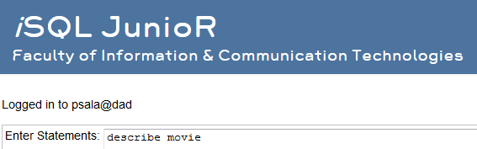
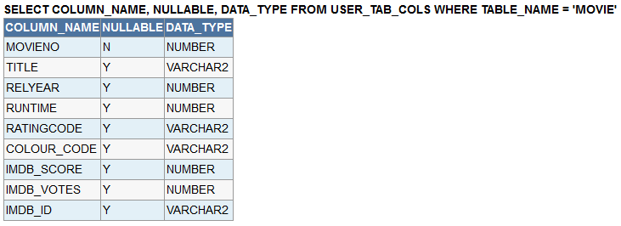
Existing Tables & Describe table
This SQL statement lists the table name of all tables that you have created
  SELECT table_name FROM user_tables; OR
  SELECT table_name FROM tabs;
This SQL statement lists the column details of a table that you have created
  DESCRIBE movie;

Slide 29
Code standards and style
Can you guess which of the statements below is easier to read?
  select rdate, temperature, rainfall from weather_readings where
  temperature <= -6.5 or rainfall >= 1000 order by rdate desc
  SELECT rdate, temperature, rainfall
  FROM weather_readings
  WHERE temperature <= - 6.5
  OR rainfall >= 1000
  ORDER BY rdate desc
Good style makes the job of code reading and maintenance easier.
  Real world queries are often 20 or 30 lines long. Good style helps
  Queries are often viewed / modified by other users / programmers
  Organisations often have a SQL style that you must adhere to
  Tutors 'hate' debugging poorly styled queries
✗
✓

